Slide 1
Software Verification Validation and Testing
Prepared by : Neha Tripathi

Slide 2
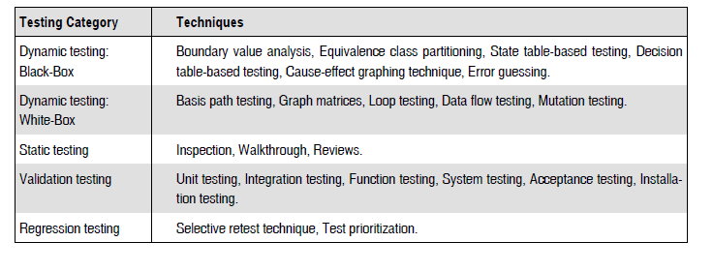
Testing techniques

Slide 3
DECISION TABLE-BASED TESTING
Boundary value analysis and equivalence class partitioning methods do not consider combinations of input conditions. These consider each input separately.
There may be some critical behavior to be tested when some combinations of input conditions are considered.
Decision table is another useful method to represent the information in a tabular method.
It has the specialty to consider complex combinations of input conditions and resulting actions.
Decision tables obtain their power from logical expressions. Each operand or variable in a logical expression takes on the value, TRUE or FALSE.

Slide 4
FORMATION OF DECISION TABLE
A decision table is formed with the following components
Condition stub It is a list of input conditions for which the complex combination is made.
Action stub It is a list of resulting actions which will be performed if a combination of input condition is satisfied.
Condition entry It is a specific entry in the table corresponding to input conditions mentioned in the condition stub. When we enter TRUE or FALSE for all input conditions for a particular combination, then it is called a Rule. Thus, a rule defines which combination of conditions produces the resulting action.
Action entry It is the entry in the table for the resulting action to be performed when one rule (which is a combination of input condition) is satisfied. ‘X’ denotes the action entry in the table.

Slide 5
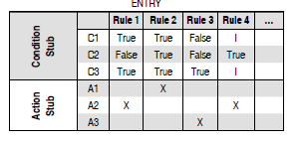
Decision table structure

Slide 6
Guidelines to develop a decision table
The guidelines to develop a decision table for a problem are discussed below :
List all actions that can be associated with a specific procedure (or module).
List all conditions (or decision made) during execution of the procedure.
Associate specific sets of conditions with specific actions, eliminating impossible combinations of conditions; alternatively, develop every possible permutation of conditions.
Define rules by indicating what action occurs for a set of conditions.

Slide 7
TEST CASE DESIGN USING DECISION TABLE
For designing test cases from a decision table, following interpretations should be done:
Interpret condition stubs as the inputs for the test case.
Interpret action stubs as the expected output for the test case.
Rule, which is the combination of input conditions, becomes the test case itself.
If there are k rules over n binary conditions, there are at least k test cases and at the most 2n test cases.

Slide 8
Example
A program calculates the total salary of an employee with the conditions that if the working hours are less than or equal to 48, then give normal salary. The hours over 48 on normal working days are calculated at the rate of 1.25 of the salary. However, on holidays or Sundays, the hours are calculated at the rate of 2.00 times of the salary. Design test cases using decision table testing.

Slide 9
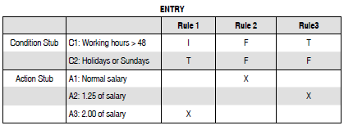

Solution
The decision table for the program is shown below:
The test cases derived from the decision table are given below:

Slide 10
Thank you!

